Slide 1

ADDIS ABABA INSTITUTE OF TECHNOLOGY
Center of Information Technology and Scientific Computing
Department of Software IT
Finger Spelling Recognition For Ethiopian Sign Language
Industrial Project Presentation
Group Members:-
Buruk Sahilu
Natnael Berhanu
Yohannes Endale
June,2018

Slide 2
Outline
Overview
Objective Of the Project
Scope of project
Use Case
Class Diagram
Implementation Tools
Testing
Demo

Slide 3
Overview
Sign language is the basic communication method between people with a hearing disability.
According to a research, over 5% of the world’s population (360 million people) has a disabling hearing loss.
There are about 138 sign languages in the world. Each sign language is named after the geographical location it is widely used in.
Sign language is a primary tool for the hearing disabled people to communicate with the community around them. But most hearing people do not have the knowledge of sign language. This situation leads to creation of a huge communication gap between the deaf and hearing people.
For this reason, the introduction of a system that recognizes sign language would have a significant benefit impact on deaf people’s social life.

Slide 4
Overview(cont’d)
The study of sign language recognition focuses on the recognition of finger spelling or the recognition of signs in different sign languages.
Sign language has its own rules, structure and grammar. The following are the basic components of sign language .
Hand shape
Hand movement
Orientation
Location
Non manual features like facial gestures.

Slide 5
Objective Of the Project
General Objective
The general objective of this study is to design a model which can interpret isolated (fingerspelling) signs in Ethiopian Sign Language and give equivalent text to a given sign.
Specific Objective
Study the structure of Ethiopian Sign Language.
Find suitable existing model to extract a sign from a given video.
Develop a method to convert the extracted sign to equivalent text.
Develop a prototype which demonstrates the translation of the given sign to equivalent text.
Test the model.

Slide 6
Scope of the Project
What are the main solution ???
The main solution of this project is to convert Ethiopia sign language alphabet to text on real time recognition.
What dose this project intended to do ??
The scope of this system is limited only to translating finger spelt Ethiopian Sign Language to Amharic Text.

Slide 7
Scope of the Project(cont’d)
Limitation
The system won’t cover this features and functionality:
This system doesn’t handle the task of translating Amharic text to Ethiopian Sign Language.
The system will not cover the study of continuous Ethiopian sign language.
The system will not cover the recognition of non-manual feature which is facial expression.
From a computer vision perspective, this problem represents a significant challenge due to a number of considerations, including:
Environmental concerns (e.g. lighting sensitivity, background, and camera position)
Occlusion (e.g. some or all fingers, or an entire hand can be out of the field of view)
Sign boundary detection (when a sign ends and the next begins)

Slide 8
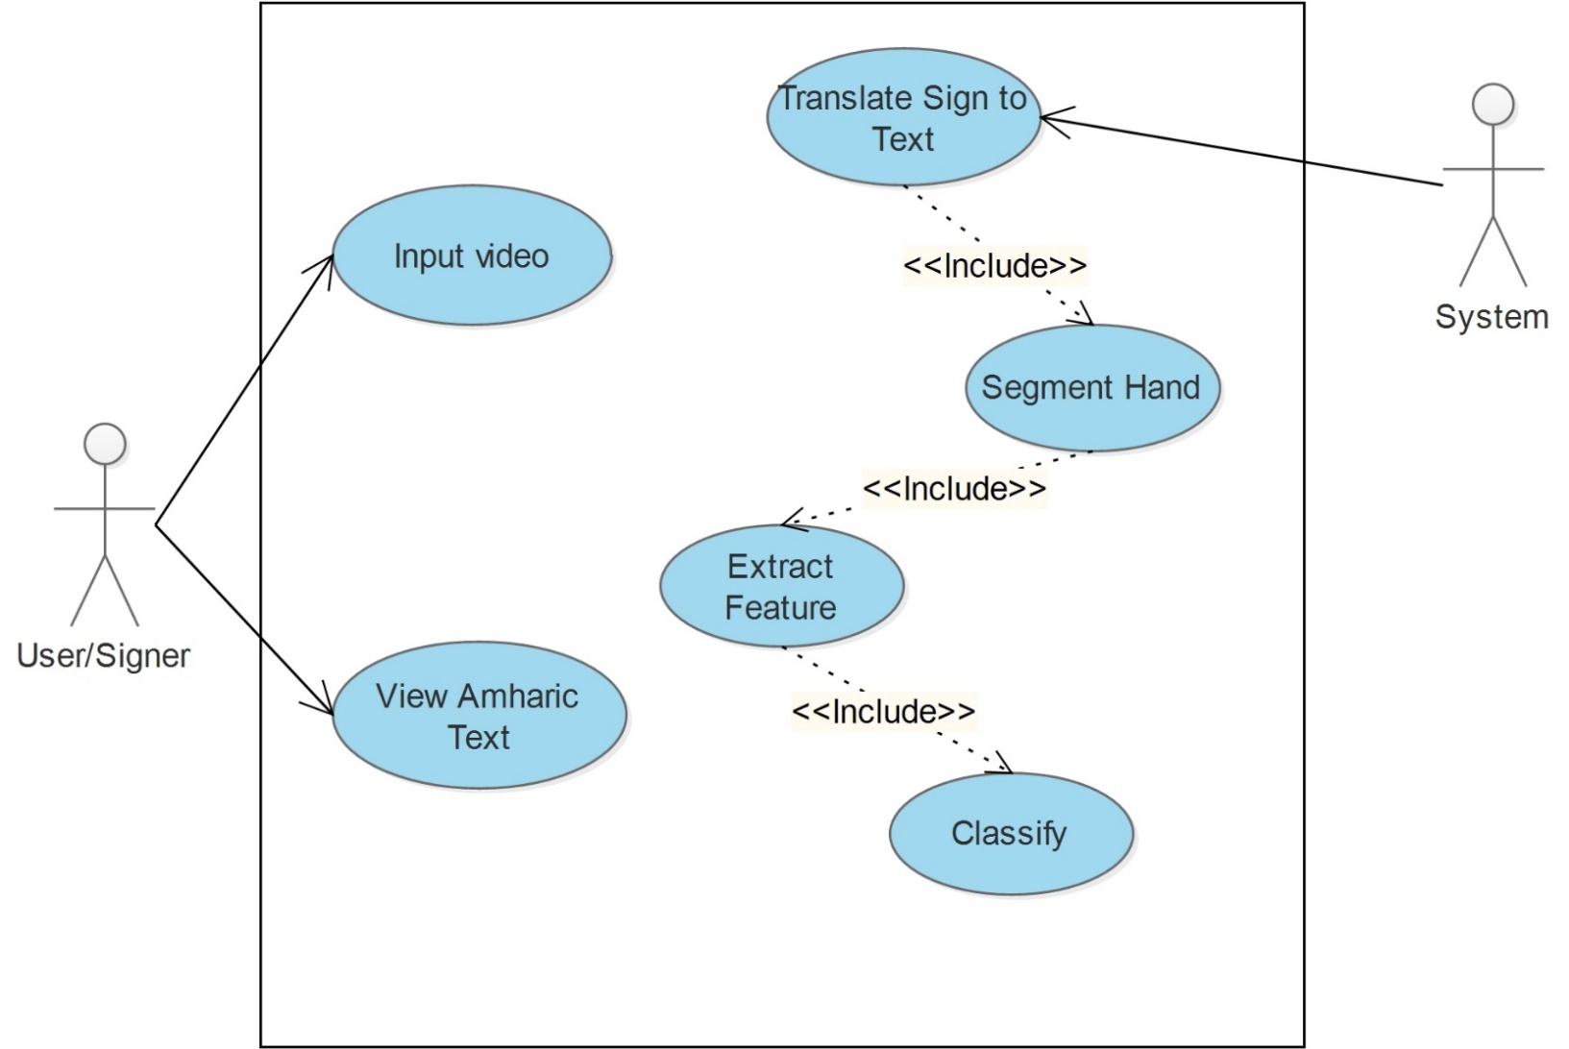
Use Case

Slide 9
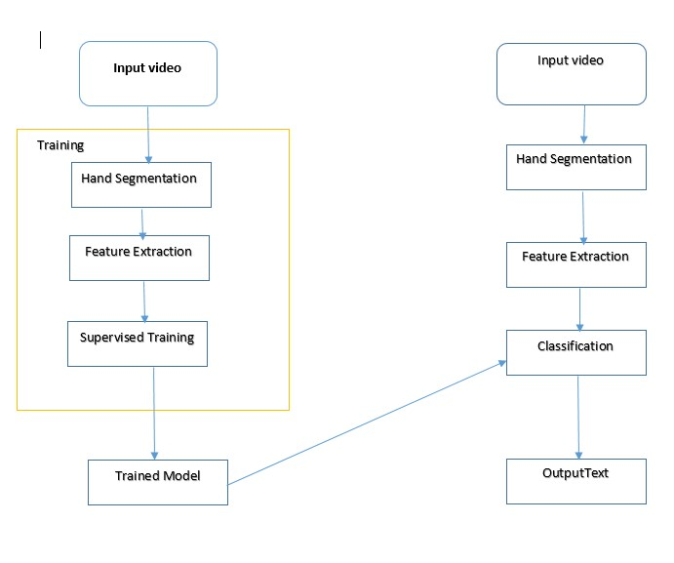
fdsaf

Slide 10
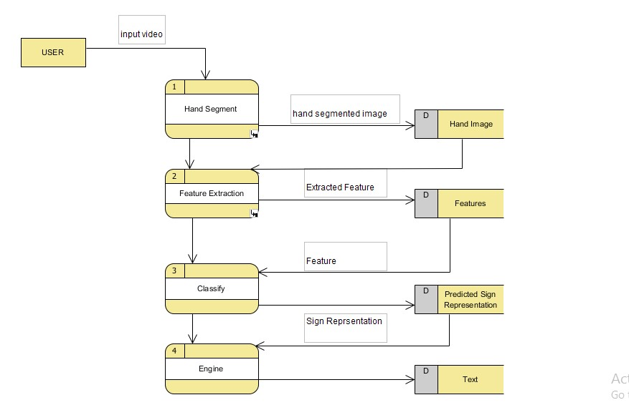

Slide 11
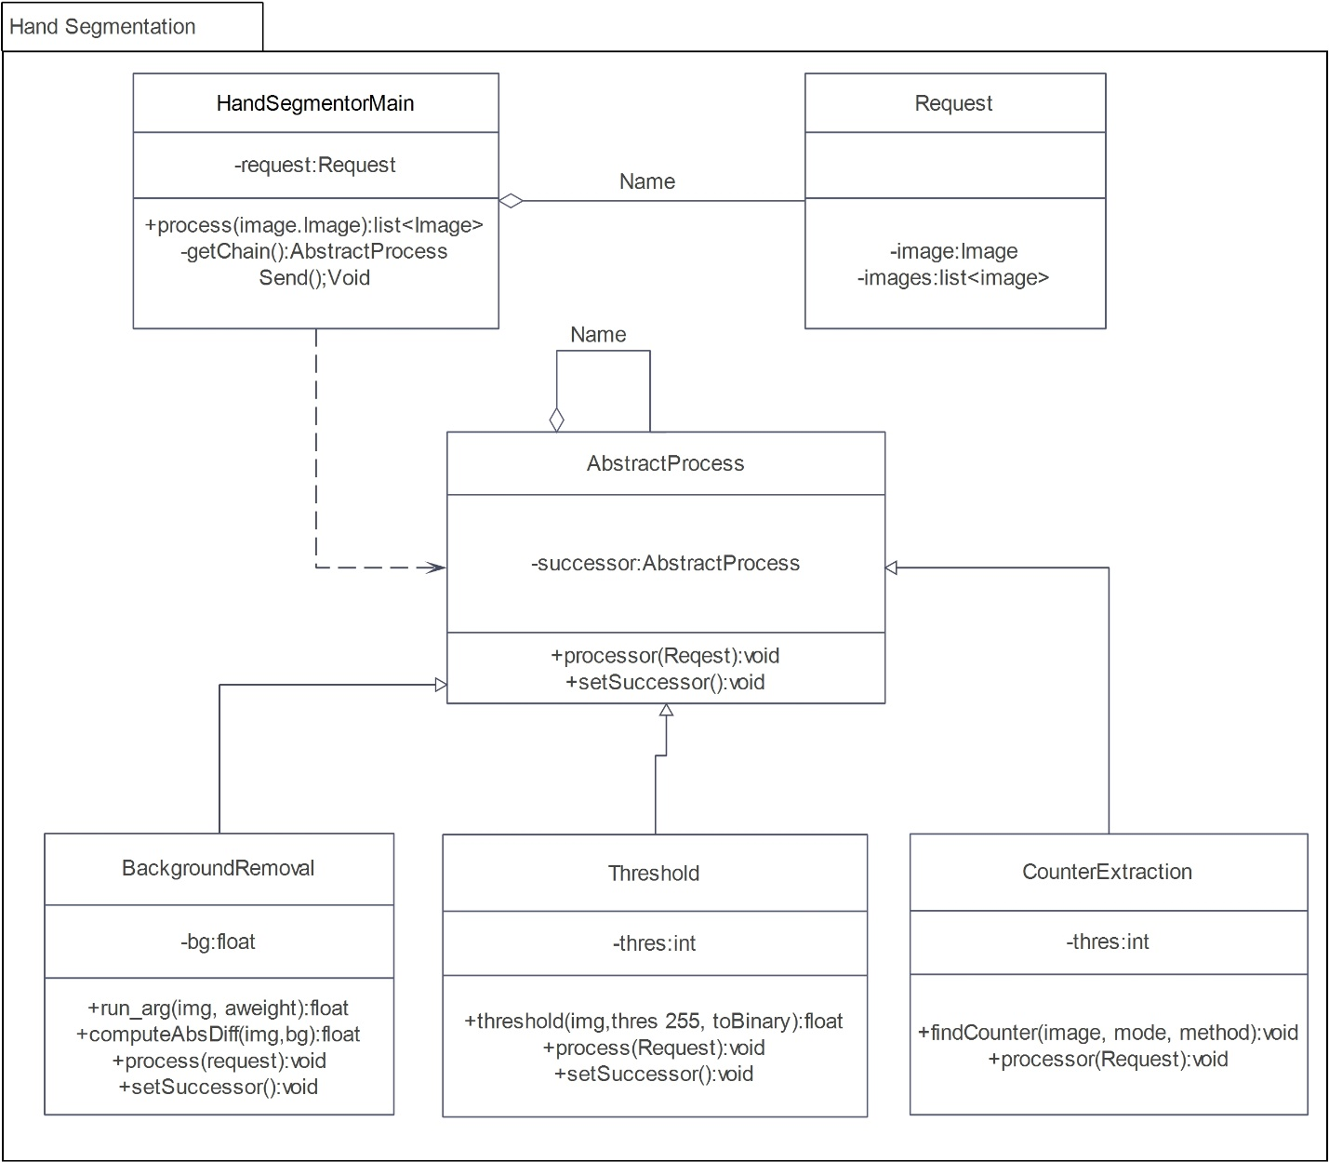
Class Diagram – Hand Segmentation

Slide 12
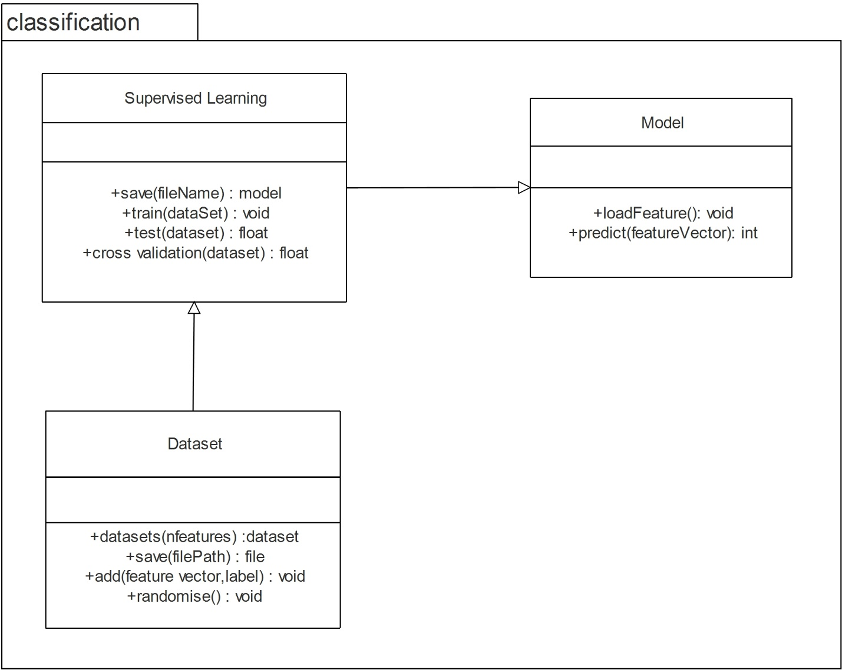
Class Diagram – classification

Slide 13
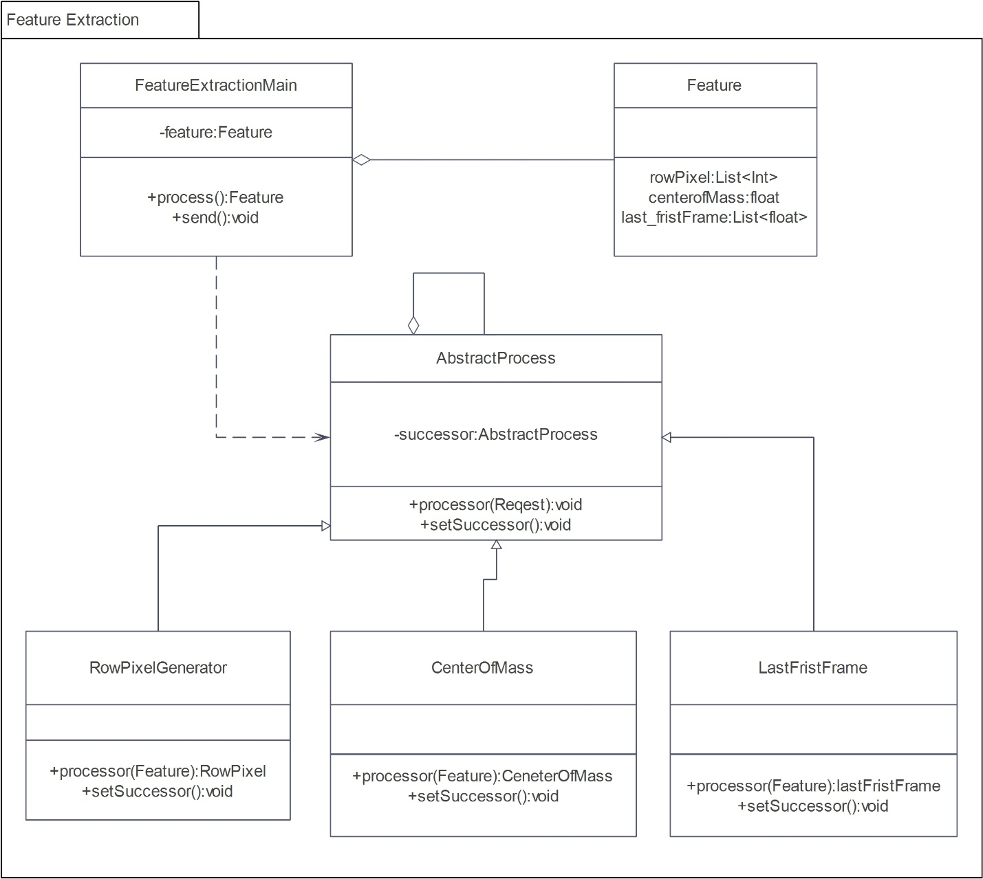
Class Diagram – Feature extraction

Slide 14
Implementation Tools
Tools
Language
Approach spiral
OpenCV is one of the most popular libraries used to develop Computer Vision applications. It enables us to run many different Computer Vision algorithms in real time. It has been around for many years, and it has become the standard library in this field. One of the main advantages of OpenCV is that it is highly optimized and available on almost all the platforms.
TensorFlow is an open-source software library for machine learning across a range of tasks. It is a symbolic math library, and also used as a system for building and training neural networks to detect and decipher patterns and correlations, analogous to human learning and reasoning
pyqt
Python programming language for development purpose.

Slide 15
Testing
Unit Testing
This type of testing is performed by developers before the setup is handed over to the testing team to formally execute the test cases. Unit testing is performed by the respective developers on the individual units of source code assigned areas. The developers use test data that is different from the test data of the quality assurance team.
The goal of unit testing is to isolate each part of the program and show that individual parts are correct in terms of requirements and functionality.
We have tested every components of the system before integrating to the whole system.

Slide 16
Testing(cont’d)
Integration Testing
Integration testing is defined as the testing of combined parts of an application to determine if they function correctly. Integration testing can be done in two ways:
Bottom-up integration: This testing begins with unit testing, followed by tests of progressively higher-level combinations of units called modules or builds.
Top-down integration: In this testing, the highest-level modules are tested first and progressively, lower-level modules are tested thereafter.
Integration test for our system has been done by all members of the group.

Slide 17
Testing(cont’d)
System Testing
System testing tests the system as a whole. Once all the components are integrated, the application as a whole is tested rigorously to see that it meets the specified Quality Standards. System testing enables us to test, verify, and validate both the business requirements as well as the application architecture.
The system is tested thoroughly to verify that it meets the functional and technical specifications. The system is tested in an environment that is very close to the production environment where the application will be deployed.

Slide 18
testing result

Slide 19
testing result

Slide 20
Demonstration of The System!!!!!!!!!!!

Slide 21
Question and answer ???

